Slide 1


Commonwealth of Virginia
Medicaid and Schools Program:
Specialized Transportation Reimbursement
Department of Medical Assistance Services
July 2025
https://www.dmas.virginia.gov/for-providers/benefits-services-for-providers/school-based-services/

Slide 2
Agenda
Review definitions
Administrative vs. direct transportation costs
Reimbursement methodology
Elements of a transportation cost report
Transportation student statistics

Slide 3

Specialized Transportation Definition
Transportation to a medically necessary service (from home to school and back home, or to an alternative site) provided in a specially-adapted vehicle.
The medical need for the specially-adapted vehicle must be identified in the student’s IEP.
The medically necessary service(s) must also be identified in the student’s IEP (e.g. PT, SLP, nursing, personal care, etc.).

Slide 4
Specialized Adapted Vehicle Definition
A specially adapted vehicle is a bus, van, or other vehicle that has been physically adjusted or designed to meet the needs of a student with a disability.
Specialized adaptations include, but are not limited to:
wheelchair lifts
ramps
special harnesses (not seat belts)
specialized environmental controls

Slide 5
Administrative vs. Direct
Separate reimbursement is available for the Medicaid Administrative work around arranging and coordinating specialized transportation and the reimbursement for the provision of specialized transportation as a service.
LEAs continue to choose to participate in one or both reimbursement opportunities
Administrative reimbursement for work to arrange/coordinate/schedule specialized transportation continues to be reimbursed through the Administrative Activity Claims (AAC) by:
Including staff who perform this work in the RMTS
The RMTS quantifies the time and it “counts” as reimbursable Administrative work
The reimbursable time percentage is applied to the staff costs included in the AAC

Slide 6
Administrative vs. Direct (2)
Costs related to the provision of Specialized Transportation are reimbursed as a direct service.
Transportation cost reports are submitted quarterly
Separate quarterly payments for your Administrative Claim and the Transportation Direct Services
Different FFP rates apply to direct services vs. Administrative costs
State share retained by DMAS is different for direct services vs. Administrative costs

Slide 7
High-level Overview: Reimbursement for Direct Provision of Specialized Transportation
%
%
%
Allowable Costs to Provide Spec. Transportation
Percent of students being transported in specialized vehicle for whom the transportation is medically necessary per the IEP
LEA average percent of trips when Medicaid-qualified health care service was provided
LEA Medicaid Eligibility Rate for IEP students receiving specialized transportation
Specialized Transportation Allowable Amount (before FFP rates applied)

Slide 8
High-level Overview: Reimbursement for Direct Provision of Specialized Transportation (2)
%
%
%
Allowable Costs to Provide Spec. Transportation
Percent of students being transported in specialized vehicle for whom the transportation is medically necessary per the IEP
LEA average percent of trips when Medicaid-qualified health care service was provided
LEA Medicaid Eligibility Rate for IEP students receiving specialized transportation
Specialized Transportation Allowable Amount (before FFP rates applied)
Next, we’ll review the categories of allowable costs that can be included in a specialized transportation cost report.

Slide 9
Cost Categories
Allowable Costs (Expenditures):
Transportation personnel
Drivers and repair / maintenance staff
EXCLUDE bus/transportation aides
Transportation contractor costs
Transportation capital costs
Depreciation costs of capital assets during their useful life (buses, capital equipment, e.g. chair lift purchased separately)
Non-personnel costs
Fuel, insurance, repair/maintenance, rentals, contract bus use

Slide 10
Capital Costs
For capital items, the quarterly expenditure claimed is the depreciation cost.
Straight line, monthly depreciation is calculated by UMass based on the information provided for each capital item.
Include only capital assets/items used in the provision of specialized transportation (including specially equipped buses, vans, and vehicles, wheelchair lifts, etc.) when:
the acquisition cost of the item is over $10,000
the estimated useful life is at least 2 years
the item was in active use for the provision of specialized transportation at least one day during the quarter.
Upon addition of any new purchased capital assets not previously claimed, a legible copy of the purchase invoice is required as supporting documentation for the asset’s acquisition date and cost.

Slide 11
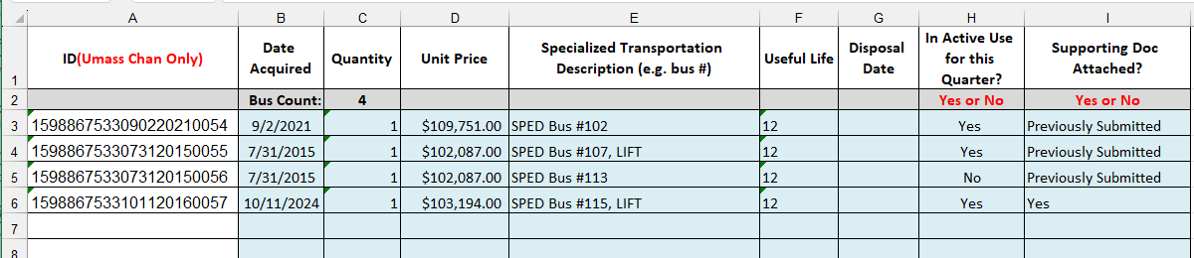
Capital Costs Worksheet
UMass will populate your quarterly template with capital items that can be carried over from the prior quarter.
Add any new items (starting in first empty row – enter only in blue boxes).
Indicate disposal dates on any items disposed or sold.
Indicate Yes/No in column H to note whether in active use during quarter.

Slide 12
Cost Allocation
For all costs (except capital) the division must report the percent of cost that is related to specialized transportation
Drivers and repair / maintenance staff
Transportation contractor costs
Fuel, insurance, repair/maintenance, rentals, contract vehicle use
LEAs may use any standard allocation method, according to GAAP and in compliance with the Super Circular accounting standards
consult your division’s Finance Director, accountant
Retain the back-up to support any allocation method used

Slide 13
Cost Allocation (2)
Regardless of cost allocation method(s) chosen, LEAs should review prior to submitting to ensure the costs are reasonable.
Some example “reasonableness tests”
Cost for fuel/insurance/maintenance divided by # of vehicles
Compare to ‘fleet-wide’ metrics

Slide 14
High-level Overview: Reimbursement for Direct Provision of Specialized Transportation (3)
%
%
%
Allowable Costs to Provide Spec. Transportation
Percent of students being transported in specialized vehicle for whom the transportation is medically necessary per the IEP
LEA average percent of trips when Medicaid-qualified health care service was provided
LEA Medicaid Eligibility Rate for IEP students receiving specialized transportation
Specialized Transportation Allowable Amount (before FFP rates applied)
Next, we’ll review the specialized transportation student statistics/counts.

Slide 15
Specialized Transportation Population
Include all students who were transported during the quarter in a qualified vehicle, regardless of whether the students themselves have specialized medical needs. This means that all students riding in that vehicle for any reason are counted in the Specialized Transportation Population.
The Specialized Transportation Population is a subset of the total LEA enrollment for the quarter – from the quarterly “snapshot” used to calculate the LEA’s overall eligibility percentages in the AAC.
Example: Q3 / March 1st “snapshot”
LEA-wide total student population snapshot = 7,542
From that snapshot list, 268 students were transported in a specialized vehicle

Slide 16
Students with Medically Necessary Specialized Transportation in IEP
From the Specialized Transportation Population for the quarter, identify the students:
who have medically necessary specialized transportation included in their IEP,
and at least one other Medicaid-covered service in the IEP.
This statistic is a subset of the Specialized Transportation Population for the quarter
Example: Q3 / March 1st “snapshot”
LEA-wide total student population snapshot = 7,542
Of that 7,542, 268 students were transported in a specialized vehicle
Of the 268 students receiving specialized transportation, 149 received medically necessary specialized transportation pursuant to their IEP, along with at least one other covered service

Slide 17
Calculated by UMass
Percent of students being transported in specialized vehicle for whom the transportation is medically necessary per the IEP
Students with Medically Necessary Specialized Transportation in IEP
149
55.6%
Specialized Transportation Population
268

Slide 18
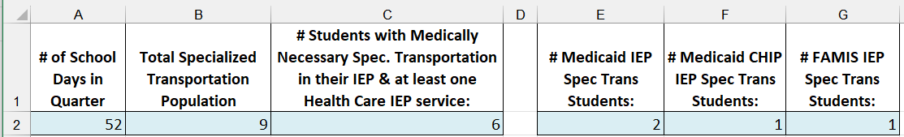

Transportation Student Statistics in three steps - overview
Transportation Student Statistics – 3 Steps
3
1
2
Page in Transportation Cost Report Template:
= 6
2.b.
2
1
= 9
3
= 4
Vehicle | Student/Rider in Quarter | Spec. Transp. In IEP? | Health Service in IEP? | Medicaid/ CHIP/ FAMIS?
Bus #1 | Student 1 | Yes | Yes | Medicaid
 | Student 2 | Yes | No | --
 | Student 3 | No | No | --
Bus #2 | Student 4 | Yes | Yes | CHIP
 | Student 5 | Yes | Yes | FAMIS
 | Student 6 | No | Yes | --
 | Student 7 | Yes | Yes | No match
 | Student 8 | Yes | Yes | Medicaid
 | Student 9 | Yes | Yes | No match
Check that no students are duplicated
2.b.
The students from step 2 who were in DW snapshot are uploaded for Eligibility Matching, the results of the match are reported in step 3

Slide 19
Transportation Student Statistics in three steps – Step One
Transportation Student Statistics – 3 Steps
3
1
2
Page in Transportation Cost Report Template:
= 6
2.b.
2
1
= 9
3
= 4
Vehicle | Student/Rider in Quarter | Spec. Transp. In IEP? | Health Service in IEP? | Medicaid/ CHIP/ FAMIS?
Bus #1 | Student 1 | Yes | Yes | Medicaid
 | Student 2 | Yes | No | --
 | Student 3 | No | No | --
Bus #2 | Student 4 | Yes | Yes | CHIP
 | Student 5 | Yes | Yes | FAMIS
 | Student 6 | No | Yes | --
 | Student 7 | Yes | Yes | No match
 | Student 8 | Yes | Yes | Medicaid
 | Student 9 | Yes | Yes | No match
Step 1: Total Specialized Transportation Population: ALL RIDERS in qualified vehicles
Check that no students are duplicated
2.b.
The students from step 2 who were in DW snapshot are uploaded for Eligibility Matching, the results of the match are reported in step 3

Slide 20
Transportation Student Statistics in three steps – Step two
Transportation Student Statistics – 3 Steps
3
1
2
Page in Transportation Cost Report Template:
= 6
2.b.
2
1
= 9
3
= 4
Vehicle | Student/Rider in Quarter | Spec. Transp. In IEP? | Health Service in IEP? | Medicaid/ CHIP/ FAMIS?
Bus #1 | Student 1 | Yes | Yes | Medicaid
 | Student 2 | Yes | No | --
 | Student 3 | No | No | --
Bus #2 | Student 4 | Yes | Yes | CHIP
 | Student 5 | Yes | Yes | FAMIS
 | Student 6 | No | Yes | --
 | Student 7 | Yes | Yes | No match
 | Student 8 | Yes | Yes | Medicaid
 | Student 9 | Yes | Yes | No match
Step 2: Of riders from step 1, who had specialized transportation AND one additional related service in IEP?
Check that no students are duplicated
2.b.
The students from step 2 who were in DW snapshot are uploaded for Eligibility Matching, the results of the match are reported in step 3

Slide 21
Transportation Student Statistics in three steps – Step two b
Transportation Student Statistics – 3 Steps
3
1
2
Page in Transportation Cost Report Template:
= 6
2.b.
2
1
= 9
3
= 4
Vehicle | Student/Rider in Quarter | Spec. Transp. In IEP? | Health Service in IEP? | Medicaid/ CHIP/ FAMIS?
Bus #1 | Student 1 | Yes | Yes | Medicaid
 | Student 2 | Yes | No | --
 | Student 3 | No | No | --
Bus #2 | Student 4 | Yes | Yes | CHIP
 | Student 5 | Yes | Yes | FAMIS
 | Student 6 | No | Yes | --
 | Student 7 | Yes | Yes | No match
 | Student 8 | Yes | Yes | Medicaid
 | Student 9 | Yes | Yes | No match
Step 2b: Check this list against your division-wide enrollment snapshot (i.e. who were enrolled in your division on snapshot date – NOT who matched to Medicaid)
You will upload the list of students to complete a match in the NEXT step. But at this point you’re still including students who don’t have Medicaid.
Check that no students are duplicated
2.b.
The students from step 2 who were in DW snapshot are uploaded for Eligibility Matching, the results of the match are reported in step 3

Slide 22
Transportation Student Statistics in three steps – Step three
Transportation Student Statistics – 3 Steps
3
1
2
Page in Transportation Cost Report Template:
= 6
2.b.
2
1
= 9
3
= 4
Vehicle | Student/Rider in Quarter | Spec. Transp. In IEP? | Health Service in IEP? | Medicaid/ CHIP/ FAMIS?
Bus #1 | Student 1 | Yes | Yes | Medicaid
 | Student 2 | Yes | No | --
 | Student 3 | No | No | --
Bus #2 | Student 4 | Yes | Yes | CHIP
 | Student 5 | Yes | Yes | FAMIS
 | Student 6 | No | Yes | --
 | Student 7 | Yes | Yes | No match
 | Student 8 | Yes | Yes | Medicaid
 | Student 9 | Yes | Yes | No match
Step 3: Report the matching results from Step 2b.
Check that no students are duplicated
2.b.
The students from step 2 who were in DW snapshot are uploaded for Eligibility Matching, the results of the match are reported in step 3

Slide 23
Student Statistics
LEAs should review the student statistics prior to submitting to ensure the information is reasonable.
Some example “reasonableness tests”
Step 1: Divide # of riders by # of vehicles (considering vehicle capacity & specialized equipment). For example:
Student requires specialized harness and rides 53 passenger bus. There are probably other students riding that bus.
Ensure your transportation person didn’t misunderstand and report only Medicaid students, or only IEP students at this point.
Step 3: If your eligibility matching results from step 3 return 100% of the students on your file as Medicaid/FAMIS, then you made an error in step 2b.

Slide 24
High-level Overview: Reimbursement for Direct Provision of Specialized Transportation (4)
%
%
%
Allowable Costs to Provide Spec. Transportation
Percent of students being transported in specialized vehicle for whom the transportation is medically necessary per the IEP
LEA average percent of trips when Medicaid-qualified health care service was provided
LEA Medicaid Eligibility Rate for IEP students receiving specialized transportation
Specialized Transportation Allowable Amount (before FFP rates applied)
Next, we’ll review the calculation of this allocation factor.

Slide 25
Percent of trips when qualified service was provided
UMass will calculate this percentage, per LEA, quarterly
Interim claim data will be used to match students receiving specialized transportation to paid interim claims for Medicaid-covered health care services (other than transportation)
DO NOT submit interim claims for transportation
From Step 3!
Note: Due to the “interim billing lag” which allows a 1-year timely filing limit, UMass will also review transportation claims annually, aligned with cost settlement process, and will initiate amendments for increased reimbursement due to the LEA if additional medical claims were submitted after the quarter’s transportation report was originally processed, if applicable.

Slide 26
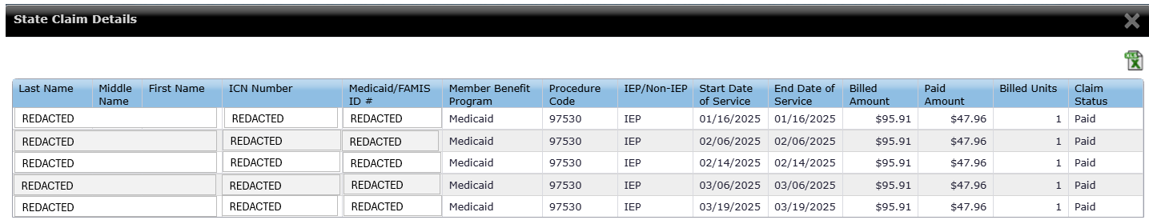
Percent of trips when qualified service was provided (2)
The list of Medicaid/FAMIS students from the results of your matching file from Step 3 of the student statistics is matched against interim claims data to determine this ratio.
Example Student: Interim claims for Q3 FY25 shows 5 days that the student received a qualified service.

Slide 27
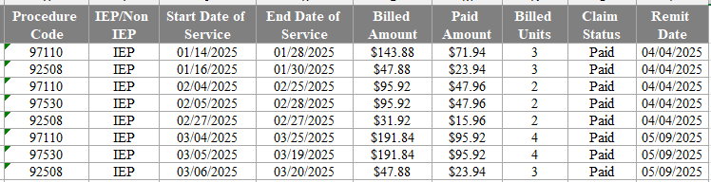
Percent of trips when qualified service was provided (3)
Example Student: Interim claims for Q3 FY25 shows overlapping days that the student received qualified services.
More information is needed to “unduplicate” the days and count accurately.
January: can only count 3
February: can only count 2
March: can only count 4

Slide 28
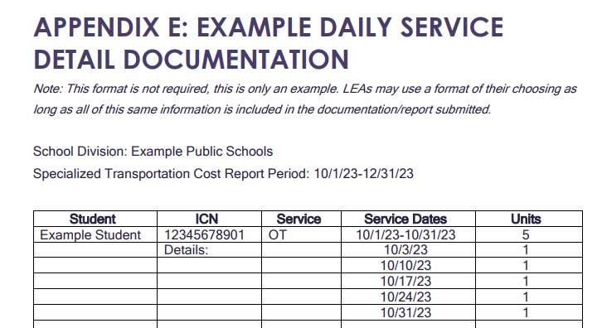
Percent of trips when qualified service was provided (4)
If you are a monthly biller, or if you bill any services by date range, then UMass cannot accurately count the number of days that the student received at least one service.
In these situations, it is strongly recommended that you submit service detail information.
Example daily documentation form in Appendix E of instruction guide:

Slide 29
High-level Overview: Reimbursement for Direct Provision of Specialized Transportation (5)
%
%
%
Allowable Costs to Provide Spec. Transportation
Percent of students being transported in specialized vehicle for whom the transportation is medically necessary per the IEP
LEA average percent of trips when Medicaid-qualified health care service was provided
LEA Medicaid Eligibility Rate for IEP students receiving specialized transportation
Specialized Transportation Allowable Amount (before FFP rates applied)
Next, we’ll review the calculation of this allocation factor.

Slide 30
What do LEAs need to track and report?
Medicaid/FAMIS Eligibility Matching for Specialized Transportation:
LEAs must determine which students with Medically Necessary Specialized Transportation Pursuant to an IEP (from slide 16) are Medicaid or FAMIS eligible for the quarter by completing a match using the UMass Eligibility Matching online system.
The results of the match (count of students in each category) are reported in the claim.
Example: Q3 / March 1st “snapshot”
Specialized Transportation Population: 268
IEP students with medically necessary specialized transportation: 149
Results of eligibility match completed using the 149 students:
Number of Medicaid IEP Spec. Transportation students: 47
Number of Expansion IEP Spec. Transportation students: 12
Number of FAMIS IEP Spec. Transportation students: 10

Slide 31
Transportation Student Statistics in three steps – step 3 review
Transportation Student Statistics – 3 Steps
3
1
2
Page in Transportation Cost Report Template:
= 6
2.b.
2
1
= 9
3
= 4
Vehicle | Student/Rider in Quarter | Spec. Transp. In IEP? | Health Service in IEP? | Medicaid/ CHIP/ FAMIS?
Bus #1 | Student 1 | Yes | Yes | Medicaid
 | Student 2 | Yes | No | --
 | Student 3 | No | No | --
Bus #2 | Student 4 | Yes | Yes | CHIP
 | Student 5 | Yes | Yes | FAMIS
 | Student 6 | No | Yes | --
 | Student 7 | Yes | Yes | No match
 | Student 8 | Yes | Yes | Medicaid
 | Student 9 | Yes | Yes | No match
Step 3: Report the matching results from Step 2b.
Check that no students are duplicated
2.b.
The students from step 2 who were in DW snapshot are uploaded for Eligibility Matching, the results of the match are reported in step 3

Slide 32
Calculated by UMass
Medicaid Eligibility Percentages for Specialized Transportation
UMass will calculate the percentages based on the statistics reported by the LEA
Category | Count of Eligible Students from Match | Medicaid/FAMIS Eligibility Percentage
Number of Medicaid IEP Specialized Transportation students | 47 | 31.54%
Number of Expansion IEP Specialized Transportation students | 12 | 8.05%
Number of FAMIS IEP Specialized Transportation students | 10 | 6.71%

Slide 33
Timelines
Deadlines for submitting quarterly Specialized Transportation reports align with your quarterly Administrative Activity Claims:
Quarter (FY) | Quarter Dates | Earliest Deadline to Submit AAC & Transportation | Certification Deadline
1 | July 1st - Sept 30th | Jan 15th | Jan 22nd
2 | Oct 1st - Dec 31st | April 15th | April 22nd
3 | Jan 1st - March 31st | July 15th | July 22nd
4 | April 1st - June 30th | October 15th | October 22nd

Slide 34

Questions?
RMTSHelp@umassmed.edu
1-800-535-6741

