Slide 1


Commonwealth of Virginia
Medicaid and Schools Program
How to Complete LEA Eligibility Matching
Department of Medical Assistance Services
August 2025
https://www.dmas.virginia.gov/for-providers/benefits-services-for-providers/school-based-services/

Slide 2

Welcome and Housekeeping Notes
My name is Emily Hall. My team at ForHealth Consulting at UMass Chan Medical School administers the Medicaid and Schools Program on behalf of DMAS in Virginia.
Please remain on mute during the presentation to reduce background noise.
If you’re accessing audio via your phone, *6 will mute and unmute.
Please take a moment to locate the Q&A feature on the Zoom toolbar where you can post questions.

Slide 3
Learning Objectives
Understand why an accurate eligibility match is important
Understand how the results of the eligibility match are used in the reimbursement process for AAC and for the Direct Medical Services Cost Report
Know the timeframes and deadlines involved
Understand how to complete an eligibility match using the web-based system
Gain some helpful tips and tools to ensure that your school division is maximizing your AAC and Cost Report reimbursement through employing a robust matching process, while meeting all program requirements

Slide 4
Eligibility Matching – Why?
Cost-Based Reimbursement Methodology
Allowable Costs for Covered Direct or Admin Services (School Division specific)
RMTS Results
(Statewide)
Medicaid Penetration Factor
(School Division specific)
Gross Medicaid Allowable Amount
$500,000 X 10% X 50% = $25,000
Significant impact on reimbursement!

Slide 5
Before you can begin…
Before any school division can begin utilizing the web-based eligibility matching system, the following items must be in place:
Privacy & Security Agreement with UMMS directly
Designee form to designate any staff to be given login access to the website and permission to perform eligibility matching tasks on behalf of the school division. There are 2 separate eligibility roles indicated on the form:
  Eligibility Uploader: Creates a school division student roster in correct upload format and template and uploads the file to the matching system
  Eligibility Reviewer: Reviews the matching results, reviews possible matches and other scenarios requiring school division decision and manual intervention to complete the match
  Roles can be assigned to the same person or to different people
  Multiple users may be assigned if needed

Slide 6
Medicaid Eligibility Matching
Medicaid Eligibility Matching is integral to the Medicaid and Schools Program.
School Divisions will need to complete a minimum of 5 matches per year as of defined effective or snapshot dates.
DMAS Eligibility Effective “Snapshot” Date | Fiscal Quarter | Results Used In (AAC / Cost Report) | School Division Students to Include | School Division Enrollment Effective “Snapshot” Date
September 1 | Q1 (7/1-9/30) | 1st Quarter AAC | Division-wide Total Enrollment | September 1
December 1 | Q2 (10/1-12/31) | 2nd Quarter AAC | Division-wide Total Enrollment | December 1
December 1 | Q2 (10/1-12/31) | Annual Cost Report | 12/1 Special Education Child Count | December 1
March 1 | Q3 (1/1-3/31) | 3rd Quarter AAC | Division-wide Total Enrollment | March 1
June 1 | Q4 (4/1-6/30) | 4th Quarter AAC | Division-wide Total Enrollment | June 1

Slide 7
Eligibility “Snapshots”
The CMS-approved reimbursement methodology prescribes the use of a “snapshot” in time on one day of the claiming period to calculate the Medicaid Penetration Factor to be used for that period.
Therefore, the Medicaid Eligibility Matching system compares:
Medicaid Enrollment File
School Division Enrollment File
*Includes all children age 2 through their 22nd birthday enrolled in Medicaid (including FAMIS) a of the snapshot date
*Includes all students enrolled in the school division as of the snapshot date

Slide 8
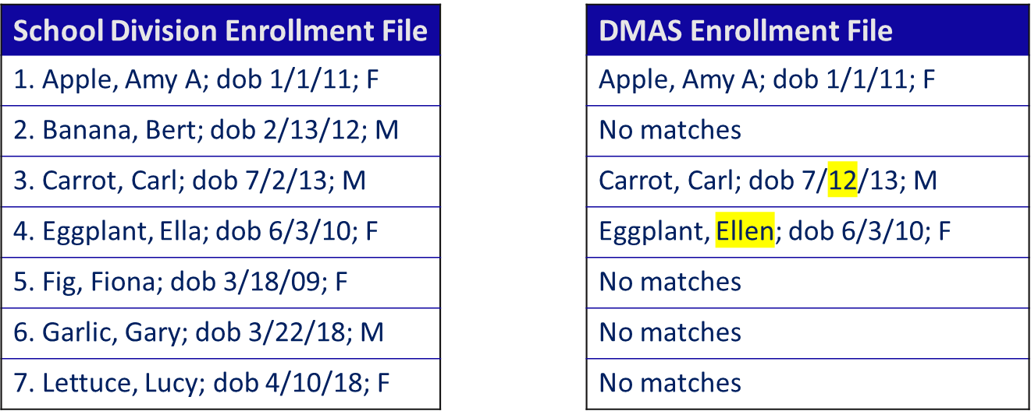
Eligibility “Snapshots” (2)
Matching Illustration:

Slide 9
Understanding “Snapshot” Data
Understanding the “snapshot” data – an example:
In my student enrollment file, my student Fiona Fig is a student that I know is enrolled with Medicaid. So why didn’t the system find a match?
Possibility #1: Fiona’s name, dob, gender is too different from Medicaid’s enrollment file information for it to match successfully.
School Division Info: DMAS Info:
Fig, Fiona; dob 3/18/09; F Onion-Fig, Flora; dob 3/18/09; F
What can I do?
  Try adding the Medicaid ID to your school division enrollment file to increase the chance of getting at least a “possible match”
  Use the “individual override” option to match with her Medicaid ID

Slide 10
“Snapshot” Example
Understanding the “snapshot” data – an example, continued:
Possibility #2: Fiona’s enrollment with DMAS was not “active” on the day that the snapshot was generated
  Eligibility can sometimes be retroactively reinstated
  Eligibility can also be retroactively terminated
What can I do?
  Try adding the Medicaid ID to your school division enrollment file to increase the chance of getting at least a “possible match”
  Use the “individual override” option to match with her Medicaid ID
  If neither of these options yields a match, then you know that some kind of retroactive activity occurred or the child simply was not eligible for Medicaid on the snapshot date. There’s nothing more to do. This student cannot be counted as “eligible” in your claim statistics.

Slide 11
Student Roster Matching Instructions
As a Medicaid Coordinator (or other designated eligibility uploader or reviewer) my best friends are the instruction guides!
Find what you need on the DMAS website page that’s dedicated to Medicaid school-based services:
  https://www.dmas.virginia.gov/for-providers/benefits-services-for-providers/school-based-services/
For Medicaid Eligibility Matching, refer to the “Medicaid Eligibility Matching User Guide”
  Step-by-step instructions
  Screenshots to help you follow along
  Sample reports

Slide 12
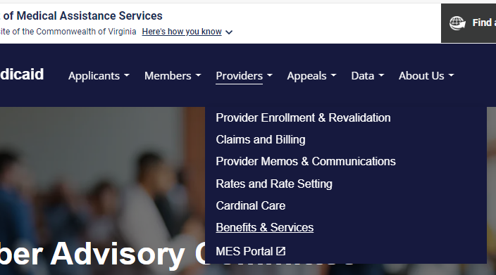
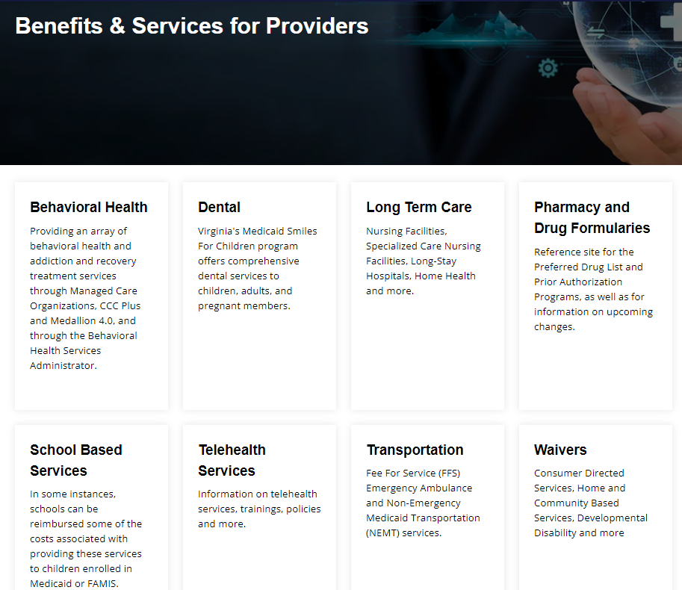
DMAS Website
Medicaid and Schools program information is easy to find on the DMAS website. You don’t have to remember the link, simply navigate to:
https://www.dmas.virginia.gov
Providers
  Benefits & Services
    School Based Services
Eligibility Matching Training
Medicaid Eligibility Matching User Guide

Slide 13
School Division Enrollment Roster
School Divisions upload their school-wide rosters including:
Student Name
Unique student ID
DOB
Gender
Address
Special Education Status
Medicaid ID (“RID”) – if known
Optional Field
Rosters must be run using a ‘snapshot’ of the School Division’s enrollment effective
as of the 1st day of the
3rd month of the quarter
(3/1, 6/1, 9/1 and 12/1)

Slide 14
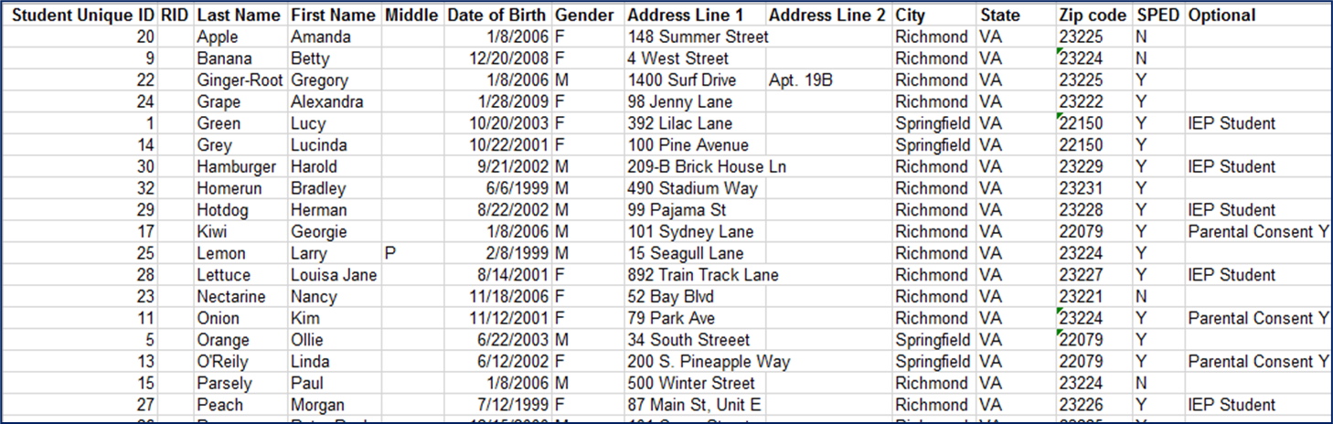
Student Roster Upload Process
Create and upload an Excel file including the required data using the correct file format and headings. Use the provided template to reduce the likelihood of formatting errors.

Slide 15
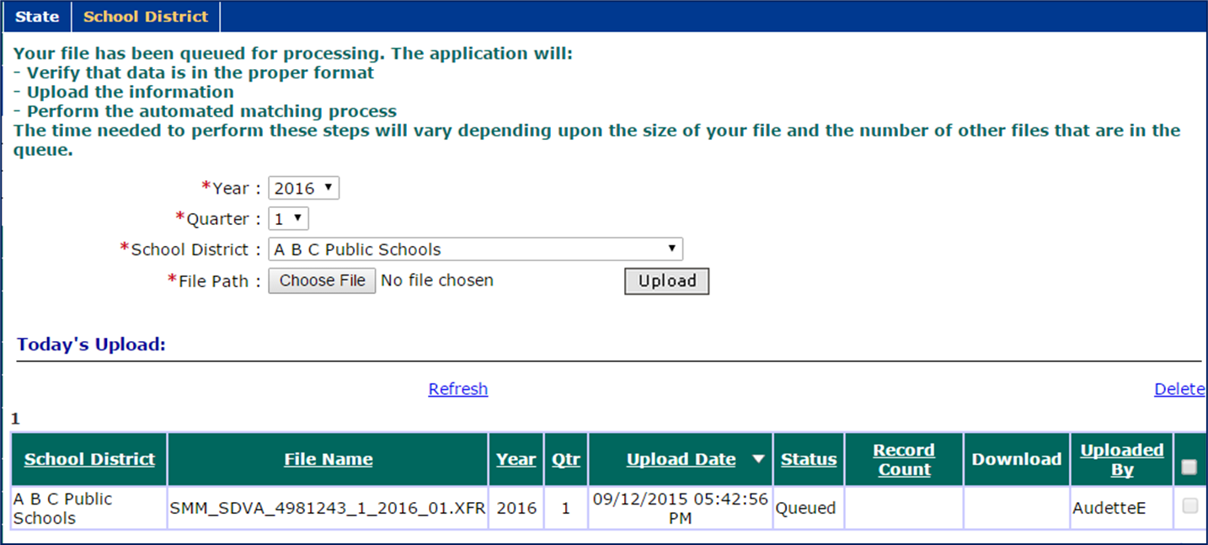
Student Roster Upload Process (2)
After successfully uploading file, the system verifies the file and completes the match

Slide 16
Matching Process
The system matching process separates students into these categories:
Eligible
May be Eligible
Not Eligible
Auto-Matched
Possible Match
Auto-Rejected
History Matched
Duplicate Match
History Rejected
Manually Matched
Review Needed
Manually Rejected

Slide 17
Matching Status Definitions
Auto Matched: These students were an exact match to a recipient in the DMAS eligibility file.
Manually Matched: These students were manually matched to a recipient in the DMAS eligibility file.
History Matched: These students exactly matched a pair of records (School Division record and DMAS eligibility file record) that was previously manually matched.
Possible Matched: These students are close matches to one or more students in the DMAS eligibility file. Further review is required by school division personnel.
Review Needed: These students were not manually matched or manually rejected. The school division reviewer assigned these records for further review.
Auto Rejected: These students were not matches or even possible matches to any recipient in the DMAS eligibility file.
Manually Rejected: These students were manually determined not to match any recipient in the DMAS eligibility file.
History Rejected: These students exactly matched a pair of records (School Division record and DMAS eligibility file record) that was previously manually rejected.
Duplicate Matched: These students are close matches to one or more students in the DMAS eligibility file. Further review is required by school division personnel.

Slide 18
Live Demonstration

Slide 19
Tips & Best Practices

Slide 20
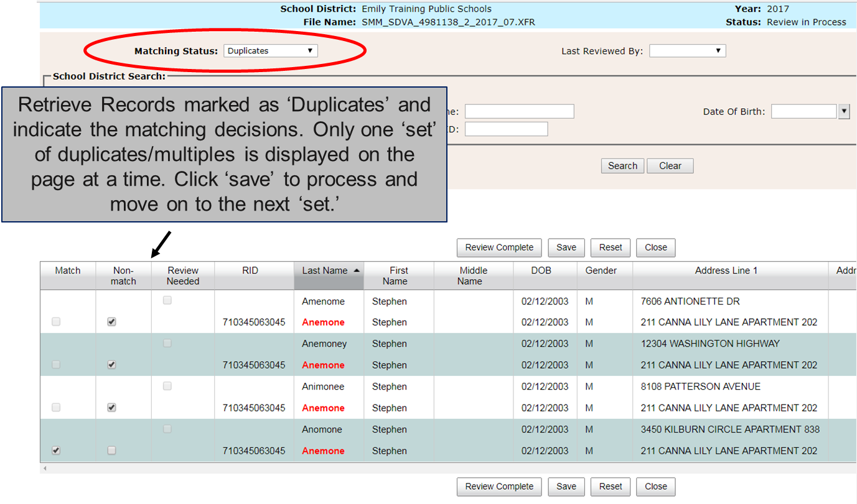
Duplicate Matches
Always process your duplicates first!

Slide 21
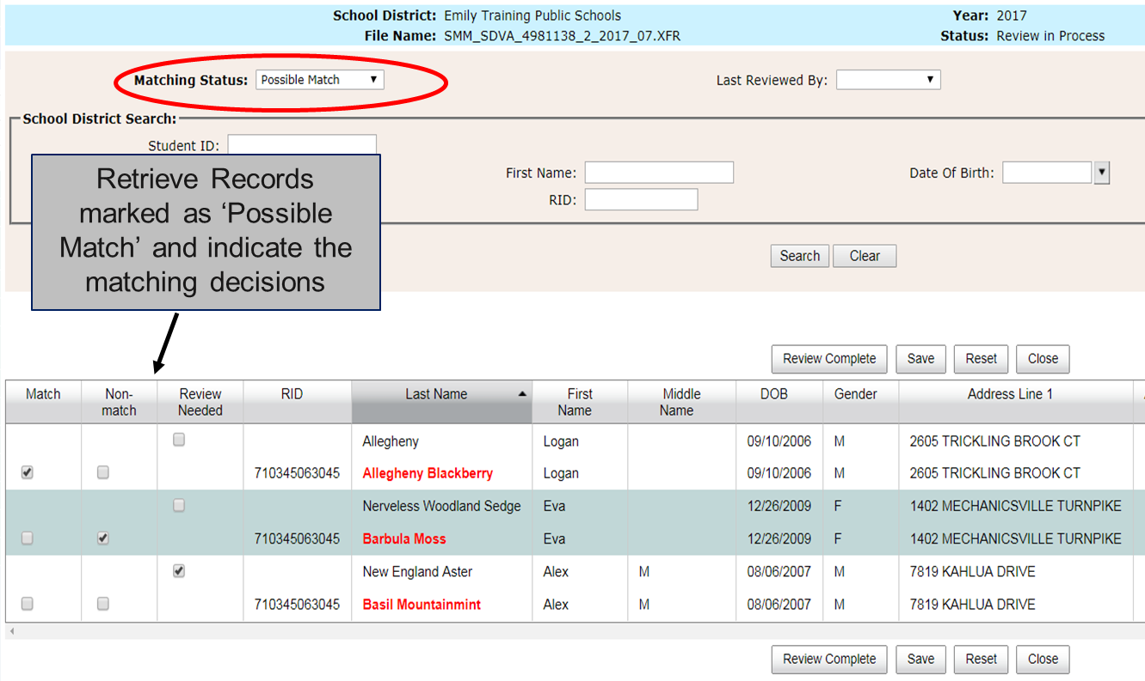
Possible Matches
Review the Possible Matches & make the matching decisions

Slide 22
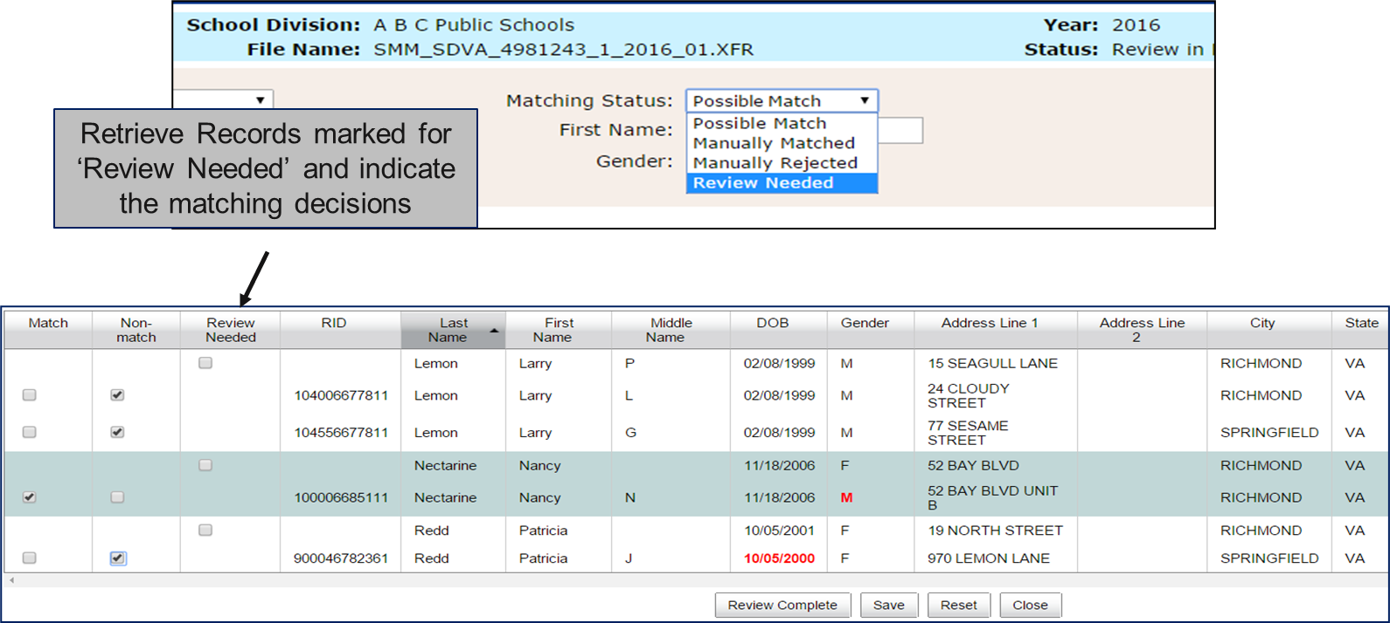
Review Needed Process
Review Needed is a way to set records aside for a more in-depth review later or by another person. But matching decisions must be made before you mark the review complete.

Slide 23
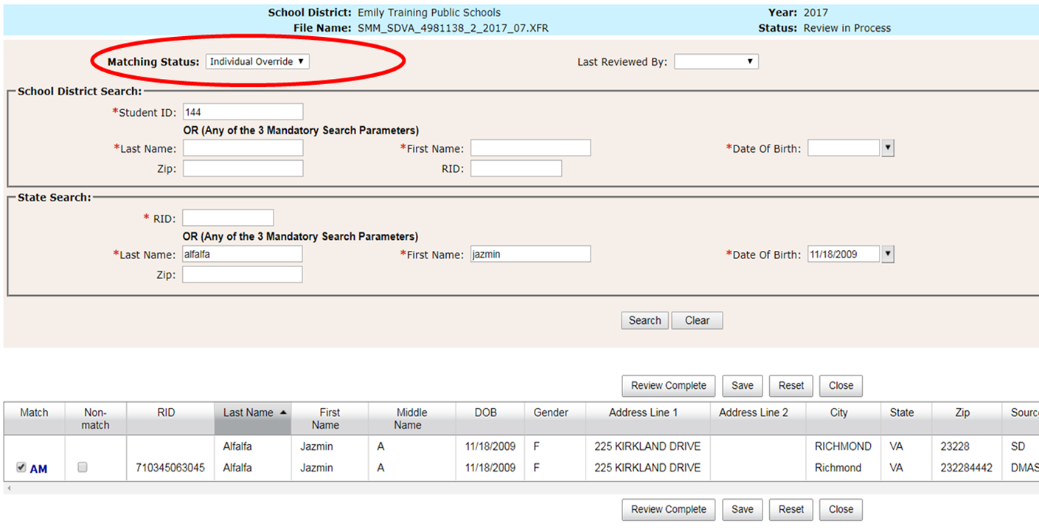
Individual Override
You can “un-match” a student from any “matched” status

Slide 24
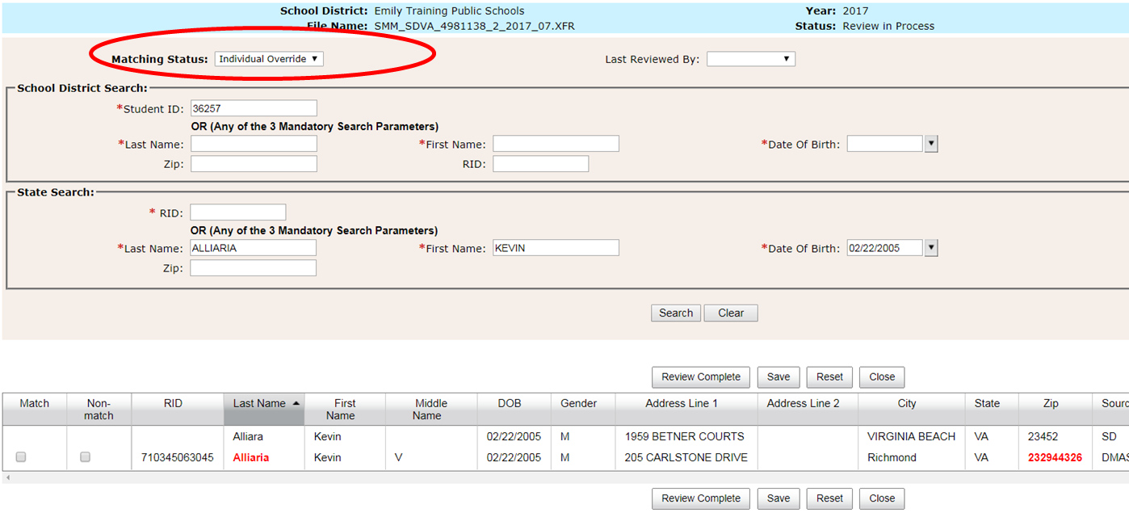
Individual Override (2)
You can “match” a student from any “un-matched” status

Slide 25
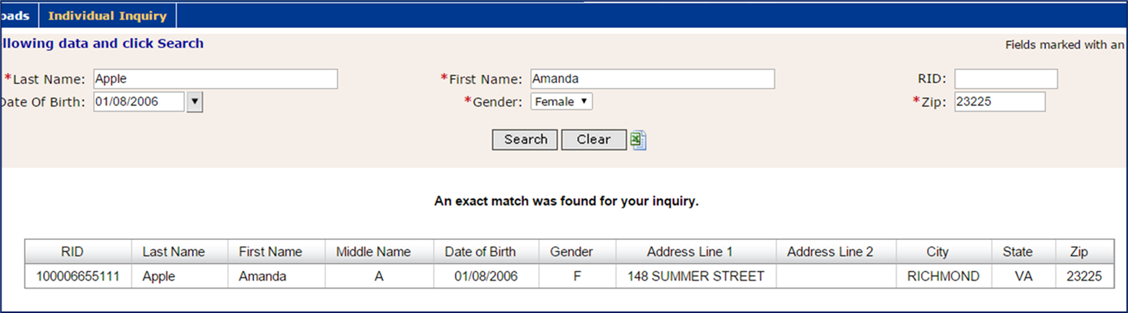
Individual Inquiry
You can look up a single student at a time using the Individual Inquiry

Slide 26
History Matching
The system remembers the history of manual matching decisions from one quarter to the next
Records left in ‘Possible Match’ or ‘Review Needed’ status are not considered in history matching
In order for a pair (School Division record compared to DMAS record) to be either ‘History Matched’ or ‘History Rejected’, the exact same pair must occur in a future quarter (Name, DOB & Gender)
‘Manually Matched’ and ‘Manually Rejected’ pairs are remembered by the system and considered in history matching
  If any of those data elements changes on either the School Division record or the DMAS record, the system will not apply history matching

Slide 27
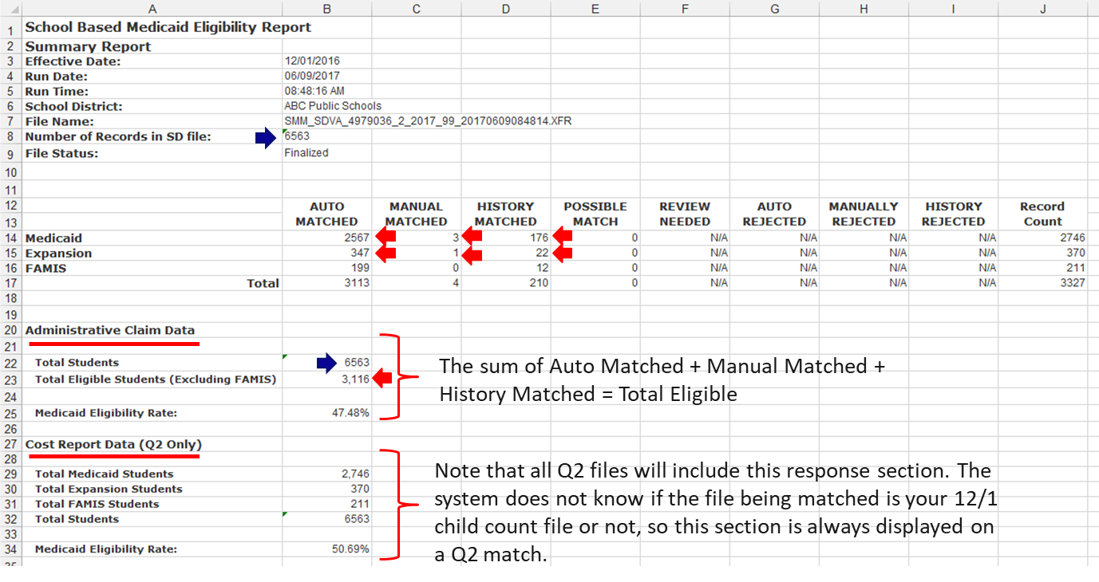
Summary Report

Slide 28
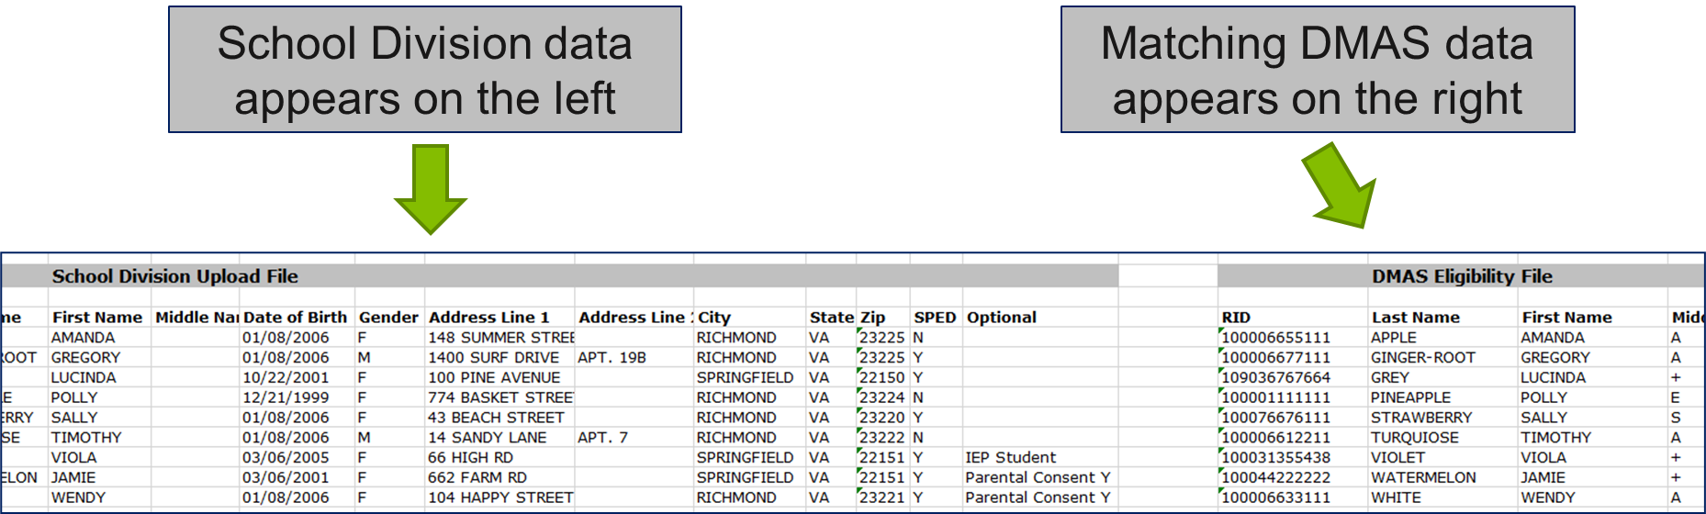
Matching Results Export

Slide 29
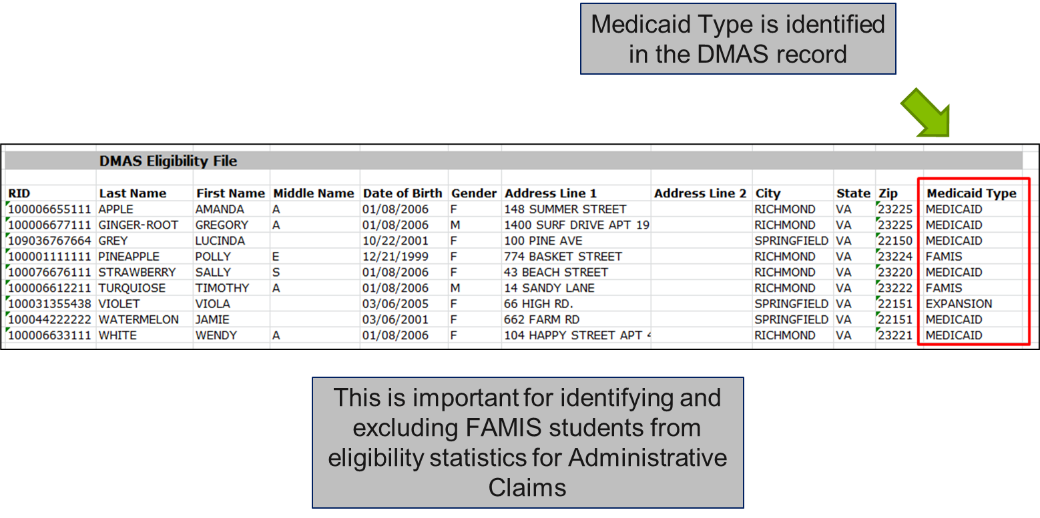
Matching Results Export (2)

Slide 30
Gender Neutral Matching
We realize that some schools aren’t gathering ‘M’ or ‘F’ gender for students
How to Match:
Match with both! Upload your student matching file with all your students listed twice – once with all ‘M’ and once with all ‘F’.
  For example: You have 500 total students to match, you would now have 500 students with ‘M’ in the gender field, and 500 students with ‘F’ in the gender field, totaling 1,000 students in your upload.
Review and complete the match, as usual.
Remove duplicates from the results.
  For students that successfully matched to Medicaid eligibility, keep the student record that matched to Medicaid (either M or F).
  For the students that did not match, keep either the M or the F (just not both)
Upload the final matching file with one record for each of your students so that you have the correct DMAS gender data and you get an accurate match.

Slide 31
Medicaid Outreach
The eligibility responses for all matched students include:
  Aid Category
  Aid Category Description
  Benefit Plan Start Date
Use this information to track when families will need to renew their eligibility and conduct outreach to help those families stay enrolled
  This work qualifies as a Medicaid Administrative activity and is reimbursable!

Slide 32
Thank You
School-Based Medicaid Help Desk
1-800-535-6741
RMTSHelp@umassmed.edu

