Slide 1
Department of Medical Assistance Services
A Health Care Services Division Presentation
August 11, 2015
1
Notes:
Have this page up while everyone settles. Then transition to opening slide #2

Slide 2
Medallion 3.0 Managed Care Behavioral Health Home (BHH) Regional Pilot Program
A Healthy Virginia Initiative

Slide 3
Managed Care Behavioral Health Home Regional Pilot Program (BHH)
The Medallion Behavioral Health Home Pilot Initiative support and care delivery:
Right Care
Right Place
Right Time

Slide 4
Managed Care Behavioral Health Home Regional Pilot Program (BHH)
Governor McAuliffe’s— A Healthy Virginia
Department of Medical Assistance Services (DMAS)
Anthem HealthKeepers
Coventry Cares
Division of Health Care Services
INTotal Health
Optima Family Care
VA Premier Health Plan
BHH Pilot Concept to Implementation

Slide 5
Managed Care Behavioral Health Home Regional Pilot Program (BHH)
Medallion 3.0 BHH Key Points
Pilot Program Structure
Assures adults with SMI benefit from coordinated
behavioral health and medical care
Unique Care Models
Team-based care coordination driven by providers who consult one another and are dedicated to improving the lives of people suffering with SMI
State Design
Developed outside the confines of the Affordable Care Act section 2703—State option to establish Health Home care model—allowed structure flexibility and faster implementation
Each plan offers a unique care model in different regions of the state with a variety of partners: MCO/CSB Partnerships, Dedicated Case Managers, Dedicated MCO staff
Care Coordination
DMAS Program Alignment
Consistent with Commonwealth Coordinated Care (CCC) program - provides coordinated behavioral health and medical care for dually eligible members

Slide 6
Managed Care Behavioral Health Home Regional Pilot Program (BHH)
BHH Pilot Members
Criteria
All Participating MCOs Use the Same Member Criteria which include Medical and BH diagnoses and related claims history
Enrollment
Members who meet criteria are contacted and offered access to the BHH pilot program through their MCO
BHH Membership
Members receive a welcome packet and receive at least one monthly BHH contact
Members may choose to stop participating at any time

Slide 7
Managed Care Behavioral Health Home Regional Pilot Program (BHH)
4 Pathways to BHH Membership
Medicaid Behavioral Health (BH) Claims History
6 or more visits with BH codes MCO or Magellan AND
High Utilization of BH RX Use
Has had 4 or more visits to a hospital ER for any (physical medicine or BH) primary diagnosis OR
History Hospital In-patient Admission
1 or more inpatient psychiatric hospitalizations in 1 calendar year AND
Has had 4 or more ER visits for any physical medicine or BH primary diagnosis AND
1 or more Medicaid claims containing a primary BH diagnoses AND
Has significant BH and Medical Claims History
History of Emergency Room Use
Received any in-office injectable antipsychotic medication AND
1 or more Medicaid claims containing a primary BH diagnoses AND
Has had 1 or more Medicaid claims containing a primary BH diagnoses AND
Has significant BH and Medical Claims History
1 or more Medicaid claims containing a primary BH diagnoses AND
Has significant BH and Medical Claims History
Has significant BH and Medical Claims History

Slide 8
Managed Care Behavioral Health Home Regional Pilot Program (BHH)
Pilots BHH Service Provision Plans
Two Choices
Plan A
Will work with Behavioral Health Services Administrator (BHSA)
4 Health Plans
Plan B
Health plan will provide all pilot services
1 Health Plan

Slide 9
Managed Care Behavioral Health Home Regional Pilot Program (BHH)
Key Quality Measures for BHH Pilot Programs
Successful monthly member contact with BHH Care Team
HEDIS Measure: Follow-up Behavioral Health Hospitalization (30 day)
Established Person-Centered Care Plans
Coordinated Care Between Behavioral Health and Medical
BHH pilot program will run for at least one year
BHH Pilot programs will be reviewed annually

Slide 10
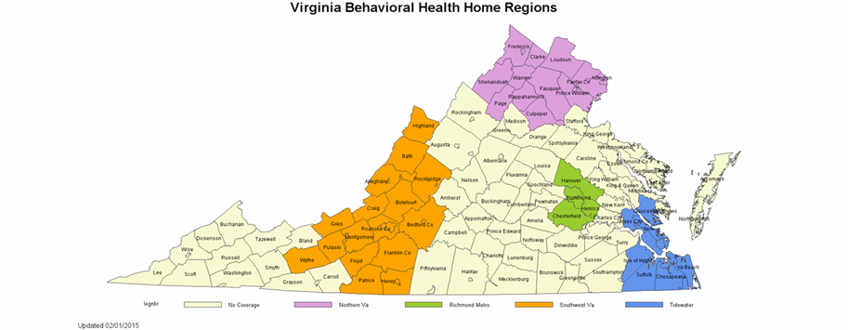
Managed Care Behavioral Health Home Regional Pilot Program (BHH)
BHH Pilot Areas of Service
5 regional Behavioral Health Home (BHH) pilot programs
Each plan has a select regional area of service
No Coverage
Northern VA
Central
Southwest
Tidewater
￼
￼
￼
￼
￼

Slide 11
Managed Care Behavioral Health Home Regional Pilot Program (BHH)
Key Quality Measures of Pilot Achievements
Successful monthly member contact with
BHH Care Team
HEDIS Measure: Follow-up
Behavioral Health Hospitalization (30 day)
Establishing Person-Centered Care Plans
Coordinated Care Between Behavioral Health and Medical Providers
BHH Pilots Evaluated annually

Slide 12
Managed Care Behavioral Health Home Regional Pilot Program (BHH)
For more information on each of the health plan BHH pilots:
Visit: http://tiny.cc/VA-Medallion-BHH
Email: BHHPilot@DMAS.Virginia.Gov
Call or visit plan’s VA Medicaid website

Slide 13
Managed Care Behavioral Health Home Regional Pilot Program (BHH)
We appreciate the dedication, assistance, support and expertise of the Magellan Team members!
Thank you for your partnership!!

Slide 14
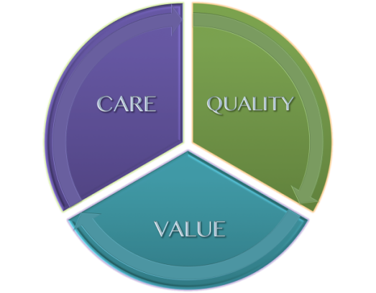
Managed Care Behavioral Health Home Regional Pilot Program (BHH)
AGENCY EXECUTIVE MANAGEMENT
Cindi Jones, Agency Director
Linda Nablo, Chief Deputy Director
Scott Crawford, Deputy Director for Finance
Suzanne Gore, Deputy Director for Administration
Karen Kimsey, Deputy Director for Complex Care Services
Cheryl Roberts, Deputy Director for Programs
HEALTH CARE SERVICES DIVISION SENIOR MANAGEMENT
Bryan Tomlinson, Heath Care Services Director
Dan Plain, Sr. Health Care Services Manager
Adrienne Fegans, Senior Program Manager
Doug Hartman, Systems and Reporting Manager
HEALTH CARE SERVICES CONTACTS
Managed Care Enrollment (Maximus) (800)-643-2273
ManagedCareHelp@dmas.virginia.gov
BHHPilot@dmas.virginia.gov
Prepared By:
Kimberly Ryan, HCS Strategic Planning & Development

