Slide 1
Utilization and Other Trends in Managed Care March 11, 2020
Ellen Montz,
Chief Deputy,
Chief Health Economist

Slide 2
Trends in MCO Expenditures
Jul - 18
Oct - 18
Jan - 19
Apr - 19

Slide 3
Medicaid Expansion Expenditures

Slide 4
Medicaid Expansion Expenditures

Slide 5
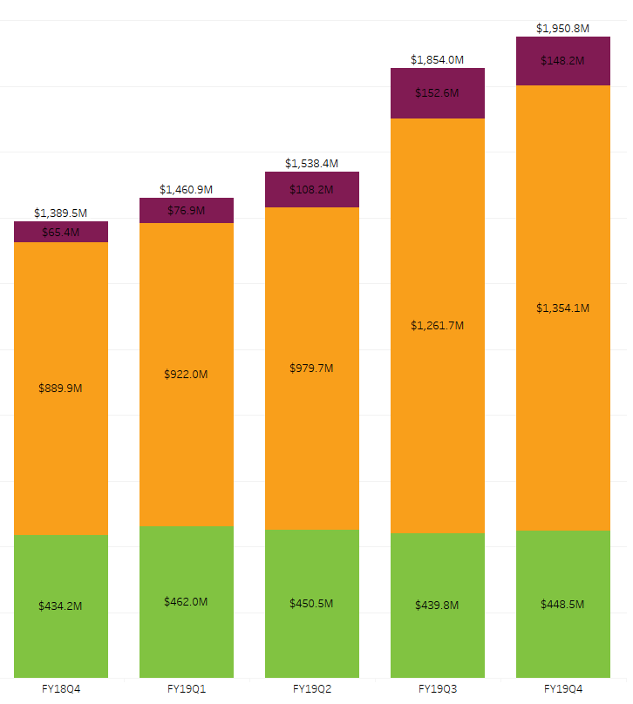
Expenditures by Service Category
Expansion
Behavioral Health
General Medical Services
Long Term Care

Slide 6
Medicaid Expansion Expenditures
Top 5 Categories of Expenditures

Slide 7
Non-Expansion Expenditures
Top 5 Categories of Expenditures

Slide 8
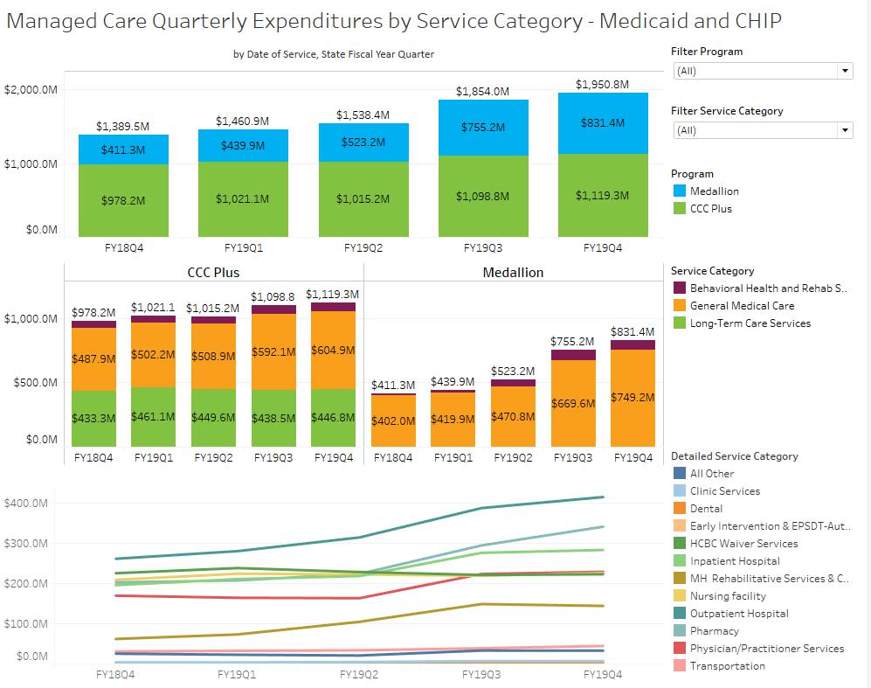
Utilization and Expenditure Dashboard Updates
Medicaid Managed Care Expenditures Dashboard
Will be published mid-April
Updated quarterly
Content includes:
MCO expenditure by service category, by program
Future content includes:
Breakdowns by population
PMPM estimates
https://www.dmas.virginia.gov/#/accessdashboard

Slide 9
Medicaid Expansion Utilization to Date
Expansion members currently enrolled: 387,045

Slide 10
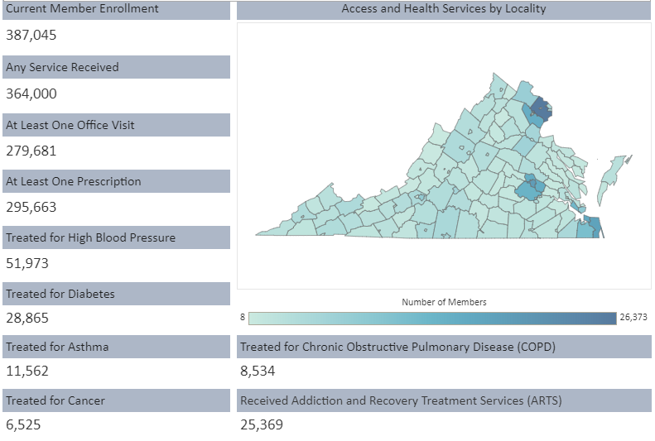
Utilization and Expenditure Dashboard Updates
Medicaid Expansion Access Dashboard
Published January 8, 2020
Updated on 1st and 15th of the month
Changes:
Will move to a monthly schedule (end of month) beginning in April
https://www.dmas.virginia.gov/#/accessdashboard

